Slide 1

Visualising Hospital Data In England
Group 3: Jacob, Salma, Rahmi, Prerna, Razvan.
Short Technical Presentation, to be followed by an interactive demonstration

Slide 2
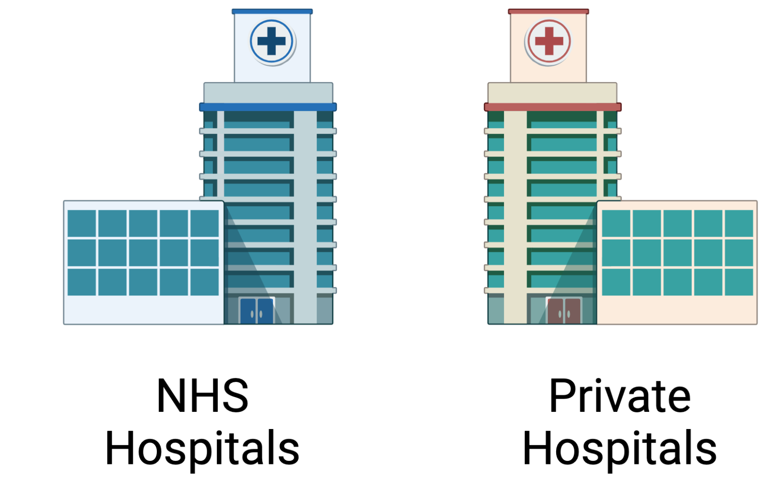
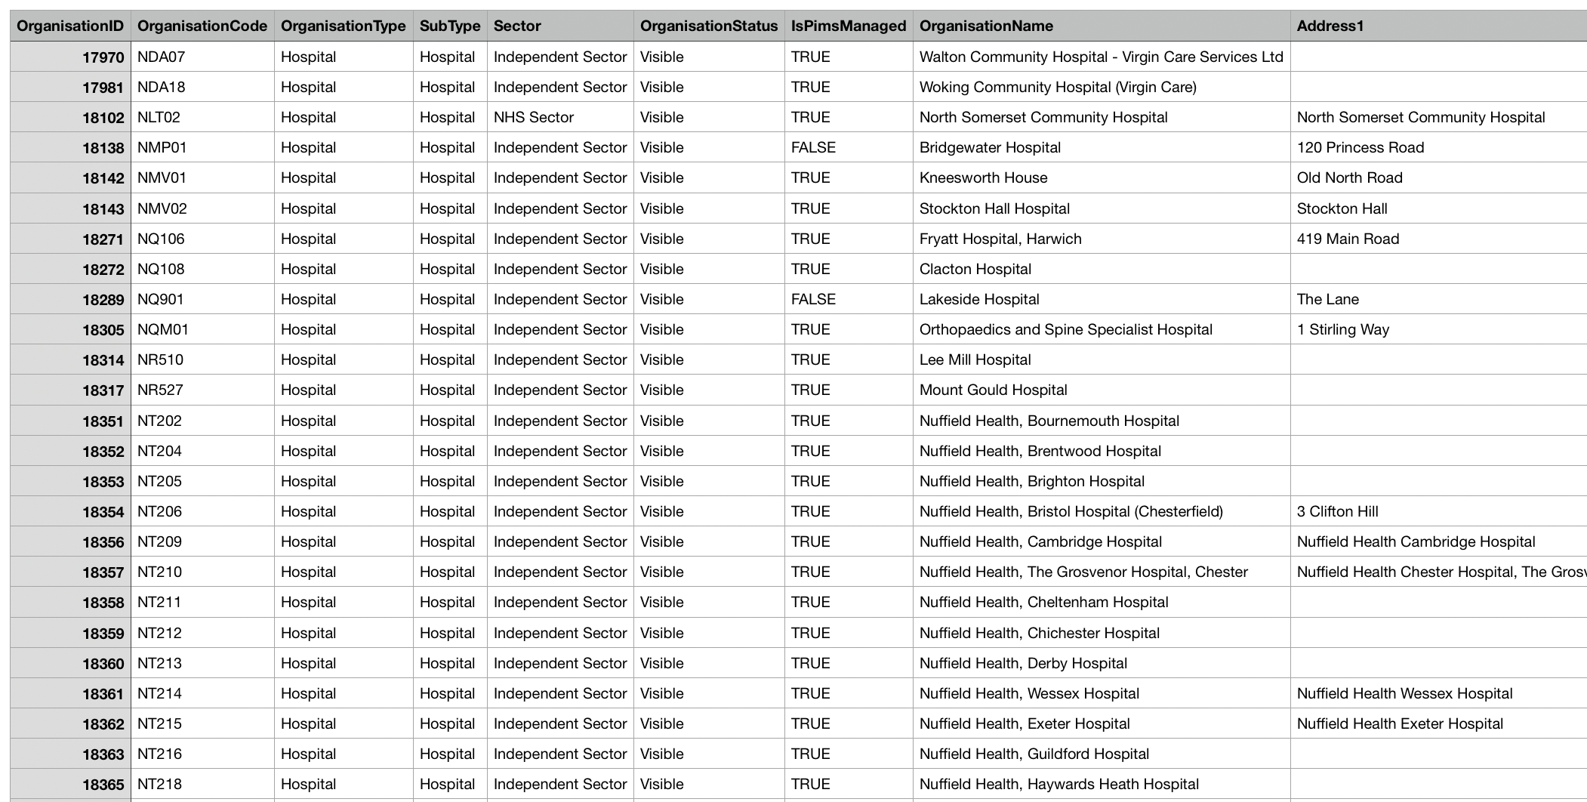
Our Project
Project Aims:
Visualize all hospital locations in England
Compare prevalence of private and public hospitals
Notes:
We built our project based around the dataset we had chosen which included information on NHS and Private hospitals in England. We wanted to create a database that helped visualise the location of such hospitals. Comparing that of the public and private hospitals.

Slide 3

Dataset
Kaggle Dataset
Unlike data directly from UK Gov it differentiates public and private hospitals
Includes NHS reference codes and so can easily be combined with NHS data
Notes:
We sourced data on NHS and private hospitals in England, which we then cleaned and stored in our local SQL database using our Flask-powered API. We visualised the different datasets in multiple ways using dynamic and interactive charts, alongside map filters.
We had sourced the dataset from Kaggle.

Slide 4
Notes:
We sourced data on NHS and private hospitals in England, which we then cleaned and stored in our local SQL database using our Flask-powered API. We visualised the different datasets in multiple ways using dynamic and interactive charts, alongside map filters.
We had sourced the dataset from Kaggle.

Slide 5
Data Sources:
NHS public data from UK.gov
https://www.data.gov.uk/dataset/73740ffe-cecb-4cba-afb9-51ea996187a1/nhs-
england-nhs-choices-hospitals-patient-comments-and-ratings
https://digital.nhs.uk/data-and-information/publications/statistical/hospital-
admitted-patient-care-activity/2020-21#resources
England hospital Data from Kaggle
https://www.kaggle.com/datasets/manchunhui/uk-hospitals

Slide 6
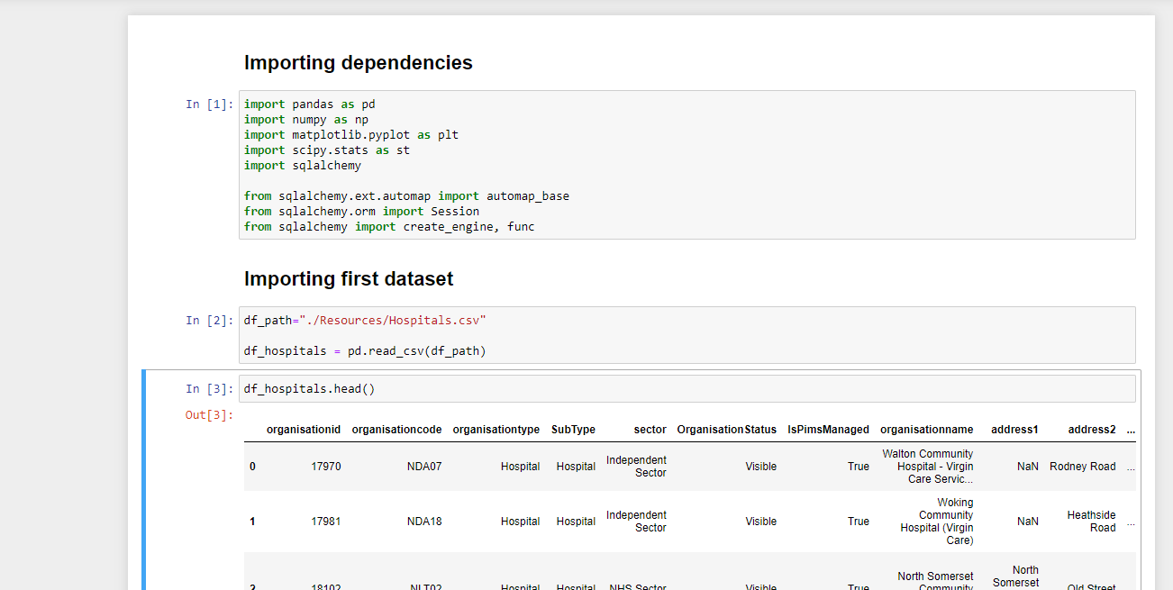
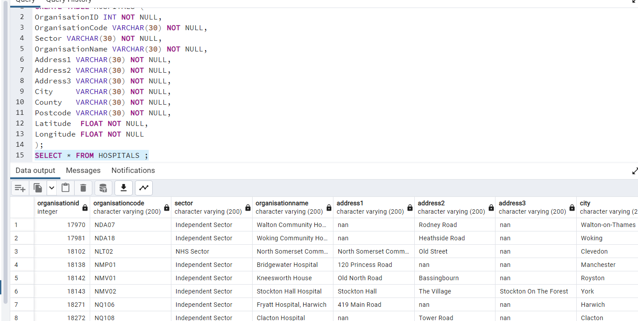
Data Cleaning
SQL
Cleaned data using pandas/ jupyter notebook
Used sqlalchemy to create connection to database

Slide 7
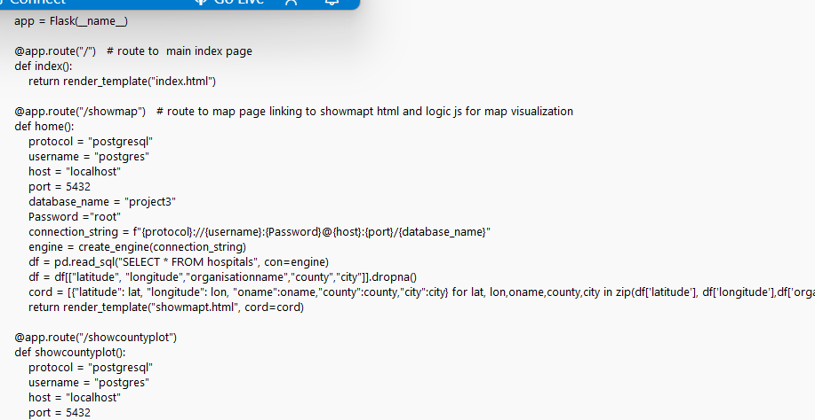
Python Flask API
Enables the combination of HTML, CSS and JS to present a webpage front-end
Can link together multiple HTML pages with buttons and links
Enables javascript elements to be impemented
Example of Flask API routing to the main index.html homepage

Slide 8
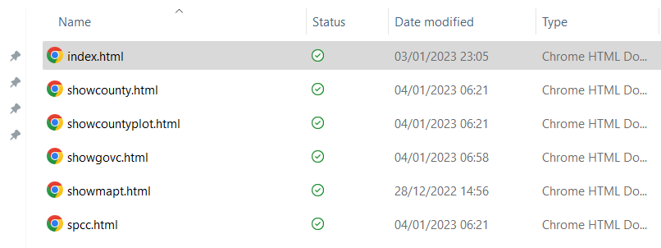
Linking HTMLs with Flask
By using multiple HTML files and linking them together with Flask, the webpage is given interactivity
Now multiple visualisations can be accessed from the homepage
In total, 6 HTML pages have routes in Flask

Slide 9
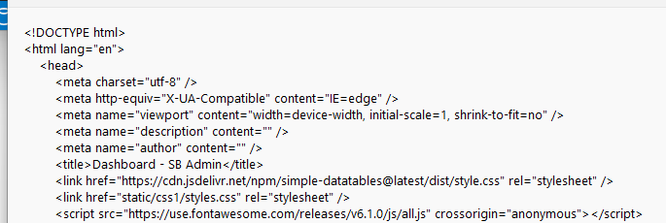
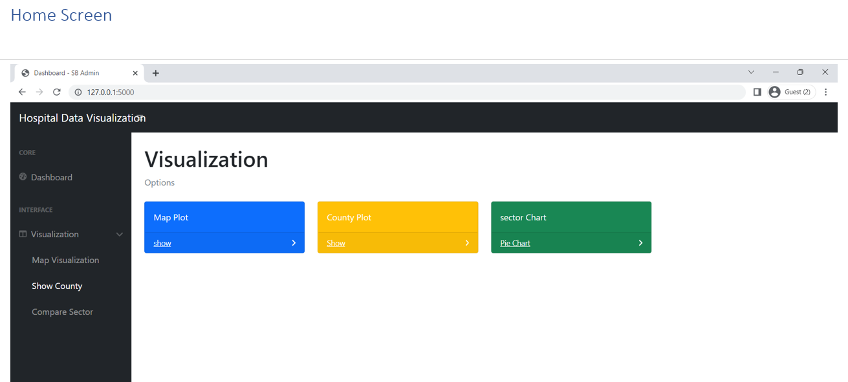
HTML and CSS
The webpage links together thanks to Flask.
HTML is the base for each webpage and CSS gives the pages style
By combining HTML and CSS, we complete the visual elements of the webpages

Slide 10
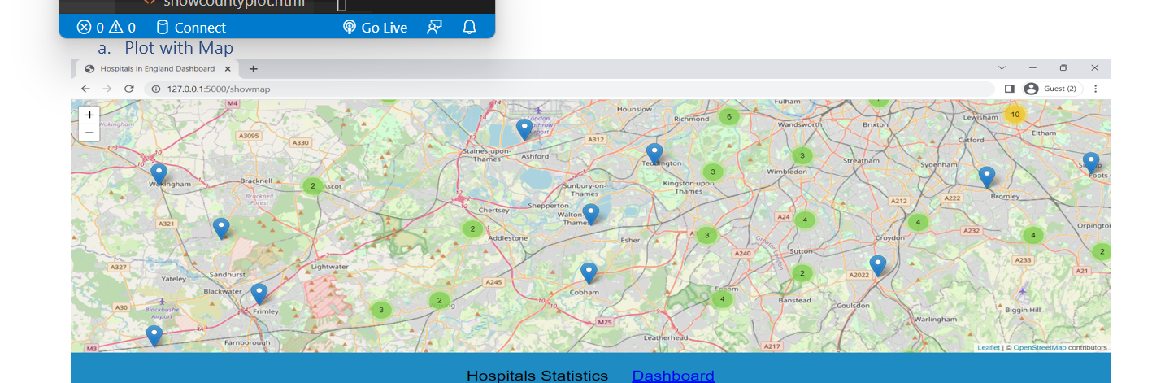
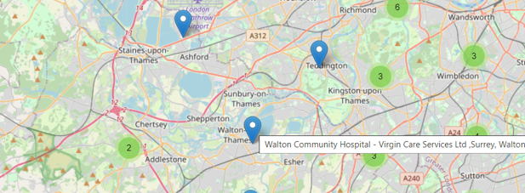
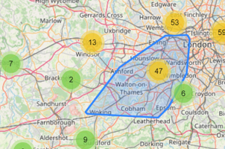
Visualisation 1 - Interactive Map
Loop through data set to retrieve lat/long and names of hospitals
Create markers and add them to a layer
Add layer/s to map
Utilised Leaflet.js

Slide 11
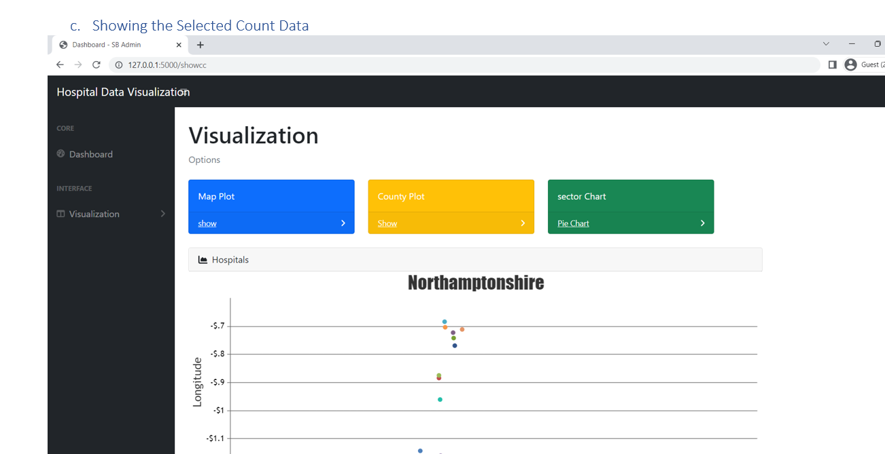
Visualisation 2 - Hospital Location Scatter Graph
Localised visualisation of the location of hospitals in specific regions using a scatter graph.
Created using Plotly.js

Slide 12
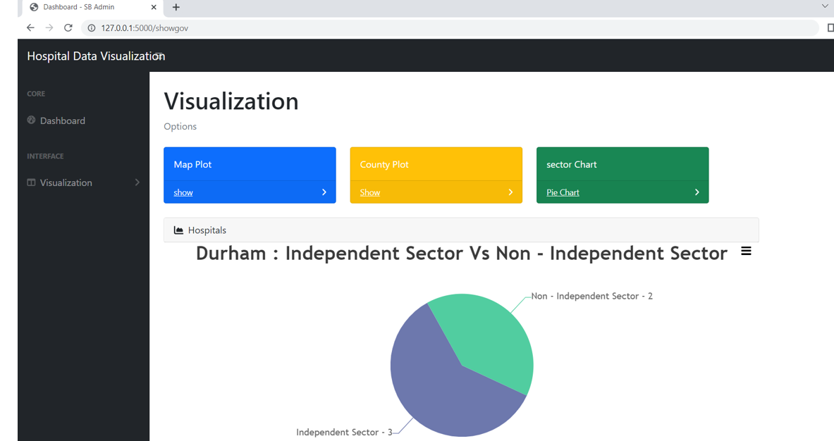
Visualisation 3 - Independent vs Non Independent Hospitals
Separated the data into counties.
Picked out the count for Independent sector and Non-independent (NHS) sector.
Visualised this through a Pie Chart.

Slide 13
Why Does this Matter?
Access to Healthcare has been an ongoing issue within England, especially since the COVID-19 Pandemic.
It is important to understand where there are gaps in access to healthcare so that these gaps can be reduced
Private healthcare is not always accessible!

Slide 14
Practical Demonstration

Slide 15
Conclusions
Diverse use of technologies
Functional Visualisations
Met the initial goals set in our aims
Limited knowledge of some tools
Difficulty forming conclusions from our data (very subjective)

Slide 16
Question Time!

